Slide 1

Absolute encoder
By Gerardo Mateo

Slide 2
table contents
Definition of Rotary Encoder
History of encoder
Introduction the type of rotary
Advantage and Disadvantage of increment and absolute rotary encoder
Incremental vs absolute
How does absolute rotary encoder work
Absolute encoder feature
TRD-NA1024NWD
Grey code
Absolute Encoder output
Summary

Slide 3
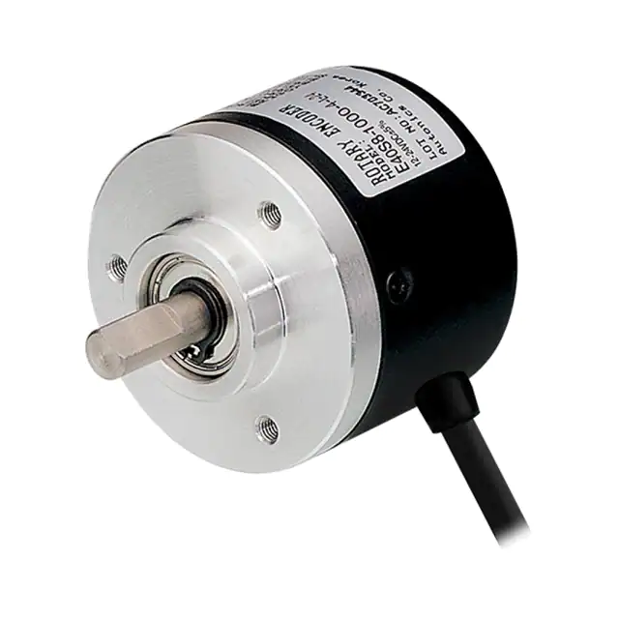
Definition of rotary Encoder
The rotary encoder is an electro-mechanical device that converts angular motions or positions into analog or digital signals.
Notes:
This definition of the Rotary encoder is to give you guy a general idea. But eventually, I will take about the absolute encoder.

Slide 4
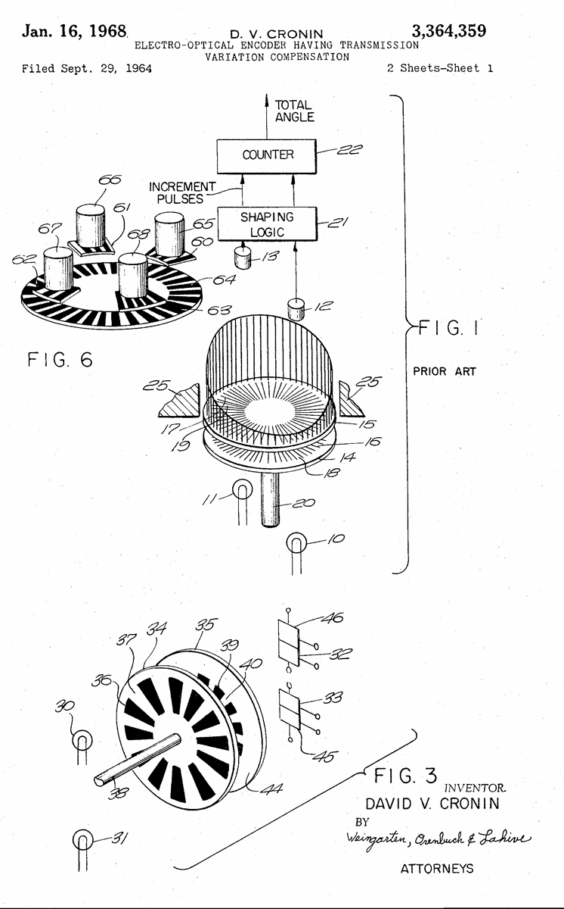
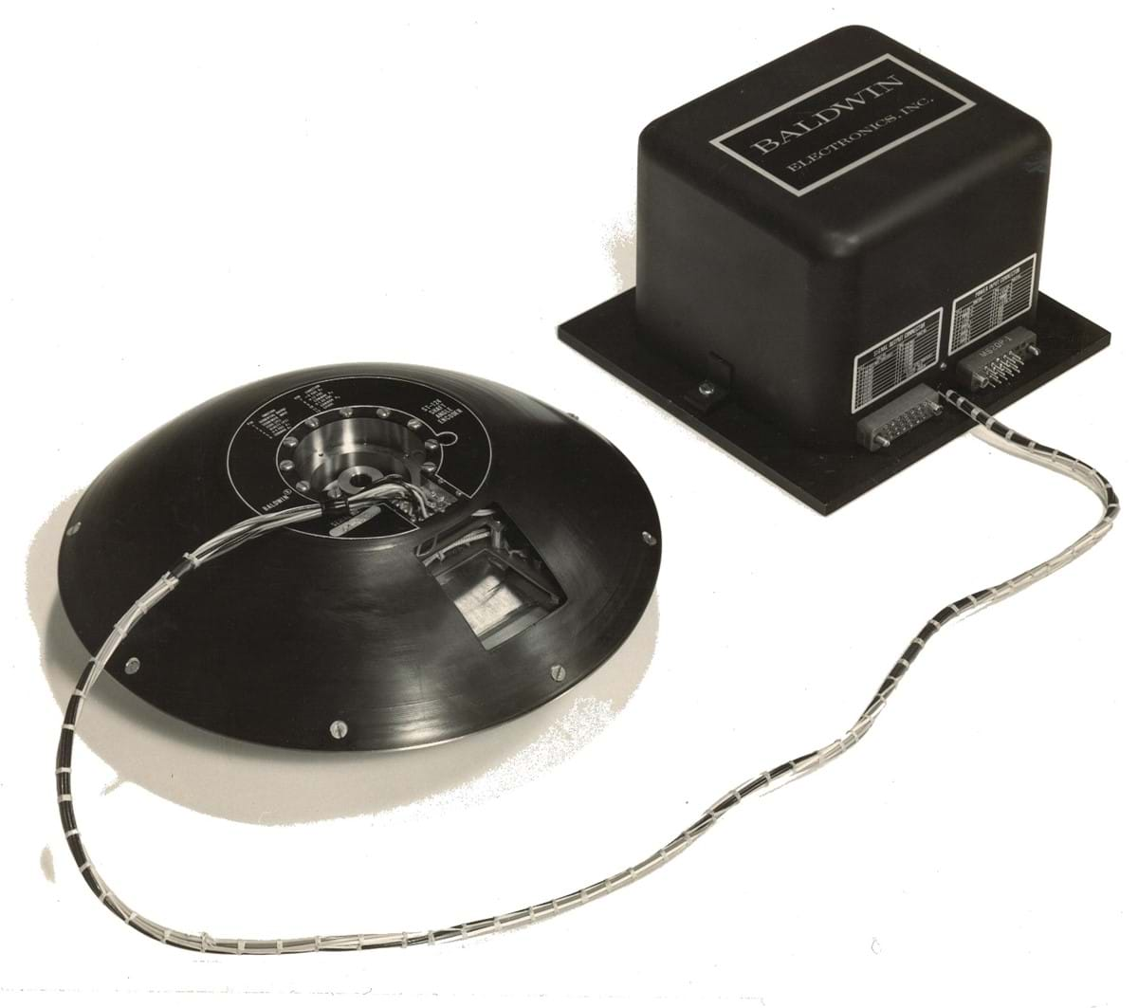
History of encoder
In 1964, David Cronin, create the first optical encoder
In 1955, Baldwin was first who first experimental optical encoder
In 1962, Baldwin research resulted into creating the first optical encoder with 18-bit resolution used in space.

Slide 5



Introduction the type of rotary
Incremental Rotary Encoder
Absolute Rotary Encoder
This Photo by Unknown Author is licensed under CC BY-SA
This Photo by Unknown Author is licensed under CC BY-SA
Notes:
Most automation companies, industrial companies, warehouse distributors, and daily life equipment use a rotary encoder. The most common rotary encoder is the increment rotary, and it usually uses to monitor speed, measure position, or measure distance. An example of a company and daily life equipment would be an old trackball mouse. Inside the old trackball mouse has an incremental encoder to check its position by counting the positional changes. Furthermore, another example would be inside of assembly line or package line would be checking the speed of a component or the distance. However, an incremental encoder is not the only type of rotary encoder. The other type of rotary encoder is an absolute rotary encoder. An absolute encoder checks the Angular position, velocity, and distance. An example that uses an absolute encoder would be a hospital bed to determine the height. The incremental and absolute rotary encoder has advantages and disadvantages, depending on the situation.

Slide 6
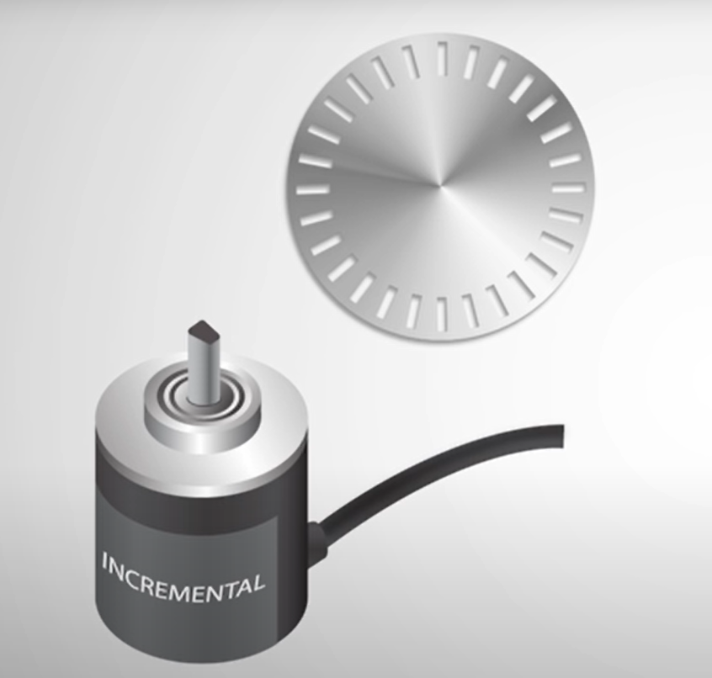
Advantage and disadvantage of increment encoder
Incremental encoder
Advantage
Cost less
Less complex
Easy to design
Disadvantage
Volatile
Disk have same mark
Need Reference point
Can be unsafe
Imprecise sometime
Notes:
The Advantage and disadvantages of both rotary encoders will tell you why I chose the absolute encoder for my team. First, let's talk about the increment rotary encoder benefit. The benefits are that the increment encoder will get information immediately, is less complex, and is easier to buy. However, the increment has some drawbacks. One of the drawbacks of this device is that increment is volatile, which means if the encoder loses power, the position or value it holds will be lost. Also, one of the benefits is a drawback to the device because if it's less complex, it means that the disk inside of the encoder has the same mark. If the disk has the same marking, then there is a chance that the encoder will read an overlapping code. Furthermore, another drawback is that the increment encoder will need a reference point to help to recalibrate or somewhere to call home. Overall, each of the advantages and disadvantages of the incremental encoder will give a general idea of when to use the component.

Slide 7
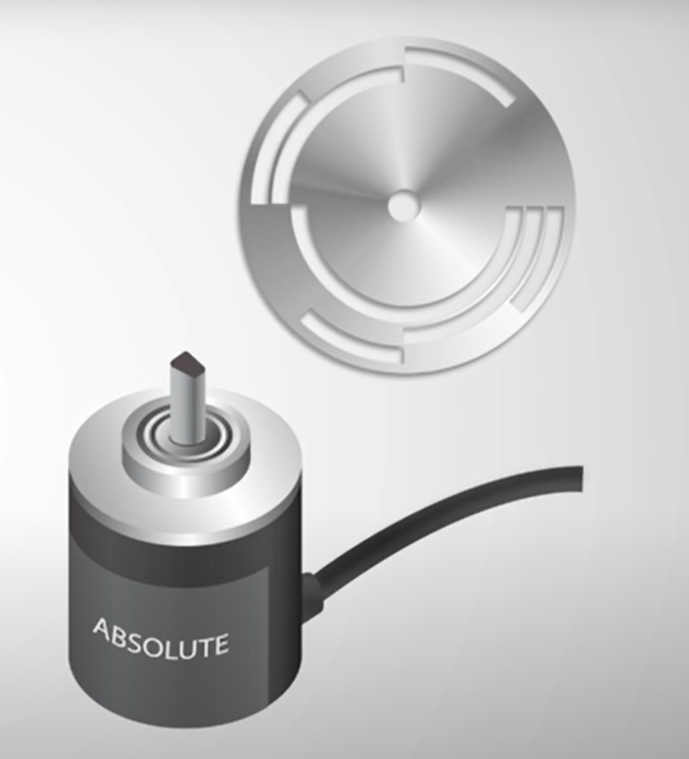
Advantage and disadvantage of Absolute encoder
Absolute encoder
Advantage
nonvolatile
No need of a fixed reference point
Higher resolution
Disk has unique mark for each position
Safe
precise
Disadvantage
High price
Complex to design
Hard to design
Notes:
Now let's talk about the absolute encoder. The benefit of the absolute encoder is that it's nonvolatile, which means the position or value will not be lost when power is lost. Also, an awesome benefit is that it does not need a fixed reference point because it is nonvolatile. Since absolute encoders are more complex, each position of the disk will have a unique mark, and each mark will help to improve the resolution. However, the disadvantages will be that it's an expensive product and hard to design due to the unique markings for each position for a particular resolution. Overall, each of the advantages of the absolute encoder overcomes the disadvantage of the incremental encoder, which means the absolute encoder is better than incremental.

Slide 8

Incremental Vs. Absolute Encoders
Incremental Encoder
Volatile
The output Square wave with two signal
Measure Relative movement
Distance
Speed
position
Can be imprecise
Absolute encoder
reliably
nonvolatile
Precise
The output unique bits for each position
Angular position, velocity, and distance
Notes:
Since I already talk about the advantage and disadvantages of both rotary encoders. Some detail about increment is that the output is a square wave produced by two signals. However, you can use one or two signal waves to help with a task that needs them. Also, incremental encoders measure specific movements and send information immediately when power is on. Additionally, the incremental encoder can miss reading the disk, leading to imprecision. The absolution encoder, however, overcomes all the problems associated with incremental encoders. Also, the absolution encoder has an output with a unique bit for each position, and it can remember the value when the power is off. Considering that the encoder is precise by a unique bit, it would be safe to say that it would help to prevent any danger. Overall, if a person needs a precise position when the power goes out, then an absolute encoder will help fix the problem. Also, this applies to the incremental encoder, but the absolute encoder has a special benefit.

Slide 9

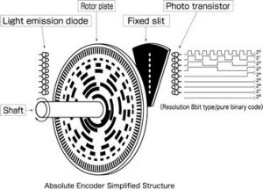
How does absolute rotary encoder work
The component
Light emission diode
Shaft
Rotor plate
Fixed slit
Photo Transistor
< Feng, Niu. “Asbolute Encoder Simplified Structure.” Https://Www.omch.co/Absolute-Rotary-Encoder/, 10 Oct. 2021. Accessed 4 Apr. 2023.
!
Notes:
I will now explain how an absolute rotary encoder works and what components it contains. The part that the absolute encoder has is the LED, shaft, Rotor plate, fixed slit, and phototransistor. Each of the components will play a part produces the output.Let's begin by rotating the shaft. When the shaft rotates, the disk will rotate along with it. Also, each LED will emit at the Rotor plate. As you can see in the picture, the rotor plate has a tiny marking, and those marking has a unique code. During rotation, the LED will pass through the mark on the disk. After passing the mark, the LED will pass the fixed slit, which allows it to emit effectively to the phototransistor. Furthermore, the transistor will detect if the LED is on or off and produce an output of 0 and 1. Overall, the picture will show what is inside the absolute and give an idea of how each component works.

Slide 10
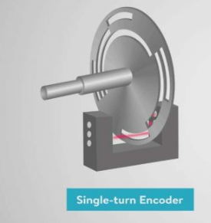

Absolute encoder feature
Single turn
multi-turn
Notes:
The absolute rotary encoder has features such as single and multi-turn. A single turn measures the position in a single rotation, and a multi-turn measures the position beyond a single rotation. Also, the multi-turn can keep track of the rotation. Both single and multi-turn have a usage in different situations. An example of single-turn encoder use in real life would be an automatic door that does not need to measure more than one rotation because the door usually opens around 180 degrees or 90 degrees. The real-life application of multi-turn would be robotic manipulators, which go beyond 360 degrees and need to track rotation.The only problem with both features would be the cost. An absolute single-turn encoder will cost more than an incremental encoder, and an absolute multi-turn encoder will cost more than both a single-turn encoder and an incremental encoder. Our group used an Absolute single turn encoder because it is reliable and costs less than a muti-turn. talk about the group when researching

Slide 11
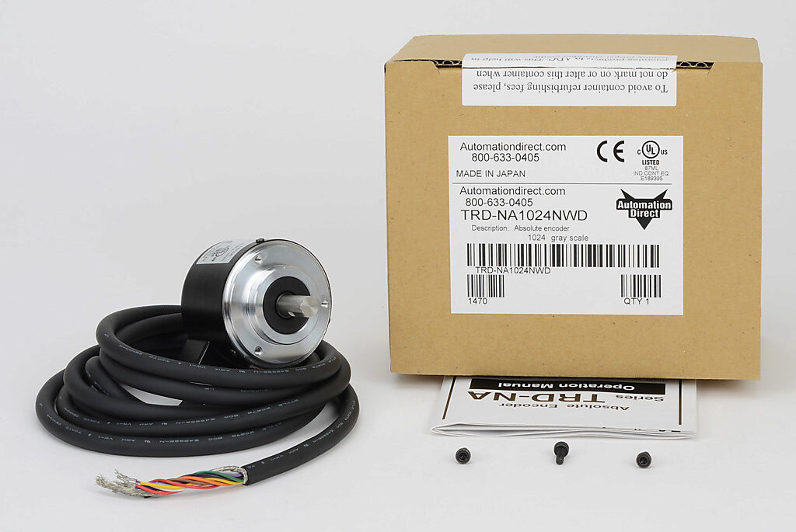

TRD-NA1024NWD
Medium duty
Single turn
Output: Gray code (10 bit)
$2^{10}=1024$ unique position
Notes:
The absolute rotary encoder that the team chose was TRD-NA1024NWD. Also, there were three reasons behind this: reliability, remembering its old value when the power went out, and good resolution. Furthermore, The reliable part is that the encoder is medium-duty, which means it can last a couple of years. In addition, the absolute encoder is a single turn, and the output is gray code. However, the resolution is 10-bit and has 1024 unique positions. The resolution will help us to get better accuracy on our steering wheel. Overall, the encoder met our condition for a capstone project, and the team installed it in the vehicle and got the information. But the downside of our encoder was that need a pull resistor to get our output and very good ground. In the next slide, we will talk about grey code.

Slide 12
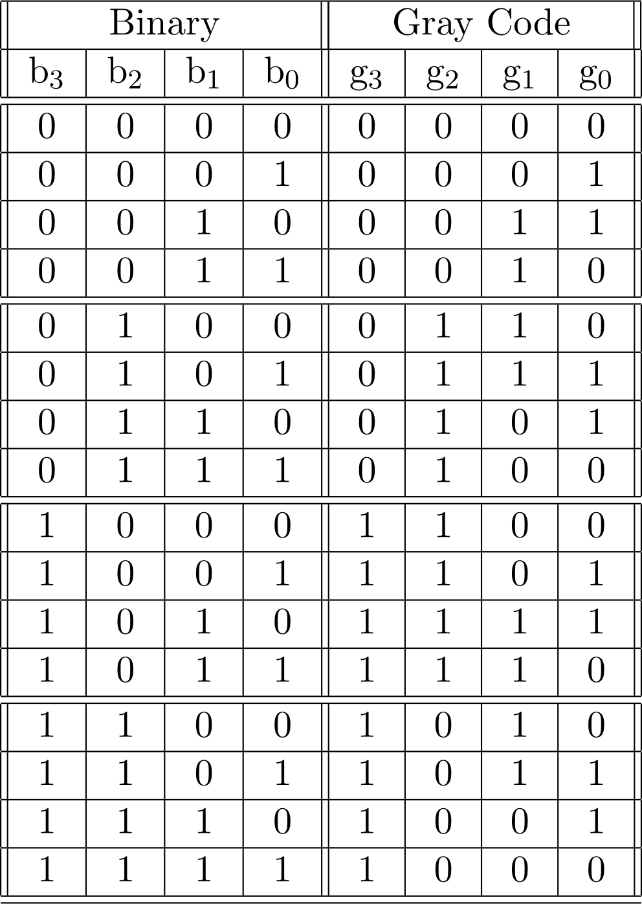
Grey code
Know as reflected binary
Frank Gray
Minimum error code
Notes:
Frank Gray created grey code, and the binary are be to be converted to gray code. Grey code is important to the absolute encoder because it helps to minimize error and become more accurate. By minimizing error, we mean reducing the switch binary. If it was binary, then there is a possible chance of an overlap bit. However, grey code gives a big advantage to the absolute encoder and gives a precise position. Also, the grey code creates a unique position on the rotor plate. In general, gray code can be useful for equipment that deals with precision or absolute encoding.
need for extra time
To convert binary to Grey code
get MSB
add the MSB to the next bit and ignore the carry
Repeat the process

Slide 13
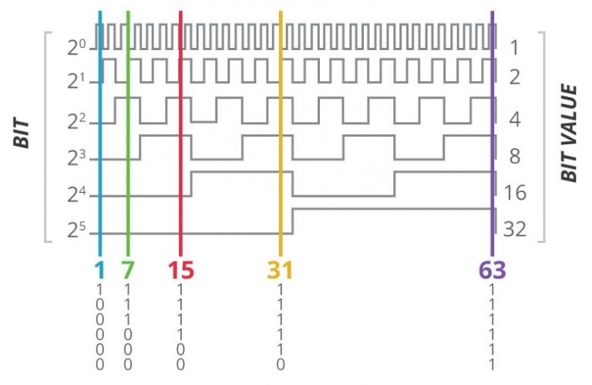
Absolute Encoder output
Three type of output
Parallel
Serial
Analog
Notes:
Absolute encoders have three types of outputs: parallel, serial, and analog. Furthermore, the most common output would be the parallel, and parallel depends on the number of wires for each bit. As shown in the picture, each bit represents a wire, and each bit helps to represent its unique position. Also, our absolute encoder is parallel and has 10 bits. The absolute encoder with serial output is usually used in microcontrollers since serial output has a clock. Further, the absolute encoder output sends one bit for each clock pulse. The analog output will depend on the position of the absolute encoder and send out a voltage signal or current signal. Overall, each of the outputs I mentioned will help you in finding the correct absolute encoder that you need. Parallel is not be the only option.

Slide 14
Summary
Notes:
Overall, incremental encoders have the advantage of constantly running machines that require little precision. In other words, the incremental encoder measures position, speed, and distance when power is on. Also, this is useful for applications that require constant monitoring of the object's movement but do not require high levels of precision. On the other hand, the absolute encoder can handle things that increments can't do. As a result, absolute encoders are more precise and safer. Also, absolute encoders are more capable to measure even the smallest movements. The absolute encoder can show the exact position of a shaft within a single revolution. Furthermore, the absolute encoder provides a backup feature that the incremental encoder does not have. If the power is cut off, the absolute encoder can still remember the position of the shaft, and the machine will not move unexpectedly.

Slide 15
Work cited
https://www.omch.co/absolute-rotary-encoder/
https://www.geeksforgeeks.org/code-converters-binary-to-from-gray-code/
https://www.usdigital.com/blog/the-strange-history-of-encoders/#:~:text=In%201955%20Baldwin%20made%20their,optical%20encoder%20used%20in%20space.
https://www.digikey.com/en/products/detail/industrialemart/E40S6-360-3-N-24/15285029?utm_adgroup=General&utm_source=google&utm_medium=cpc&utm_campaign=Shopping_DK%2BSupplier_Industrialemart&utm_term=&utm_content=General&gclid=Cj0KCQjwuLShBhC_ARIsAFod4fKGjOJ-e5vFtpab1g4Q2wTJ5YNT6sOcsFZw5U_R-Pc07aBxMObk1nsaAj4WEALw_wcB
https://realpars.com/absolute-vs-incremental-encoder/

